Slide 1






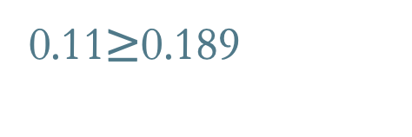

Collective risk (average annual fatal and serious injury crashes per/km)
Personal risk (average annual fatal and serious injury crashes per 100 million vehicle/km)
Risk
descriptions
Low
$≤$0.039
$<$ 4
Low-medium
0.04$≤$0.069
4 $≤$ 4.9
Medium
0.07-0.10
5 $≤$ 6.9
Medium-high
0.11$≥$0.189
7 $≤$ 8.9
High
0.19+
7 $≤$ 9+

Slide 2
Collective risk (average annual fatal and serious injury crashes per/km)
Personal risk (average annual fatal and serious injury crashes per 100 million vehicle/km)
Risk
descriptions
Low
Low-medium
Medium
Medium-high
High

Slide 3
Collective risk (average annual fatal and serious injury crashes per/km)
Personal risk (average annual fatal and serious injury crashes per 100 million vehicle/km)
Risk
descriptions
Low
$≤$0.039
$<$ 4
Low-medium
0.04$≤$0.069
4 $≤$ 4.9
Medium
0.07-0.10
5 $≤$ 6.9
Medium-high
0.11$≥$0.189
7 $≤$ 8.9
High
0.19+
7 $≤$ 9+

